Slide 1
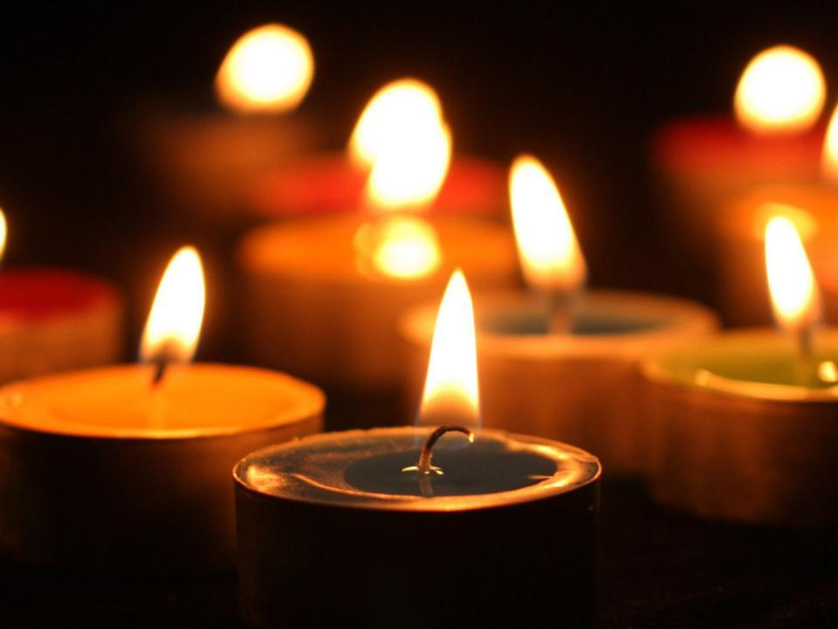
BNS Reflections
Honoring the Legacies That Have Gone Home

Slide 2
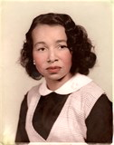
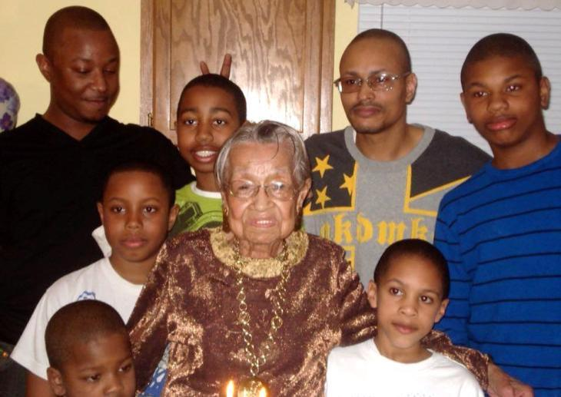
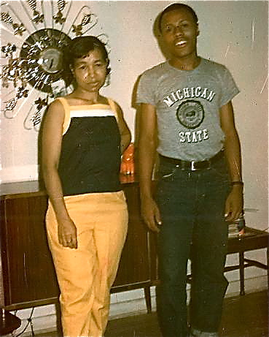
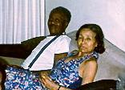
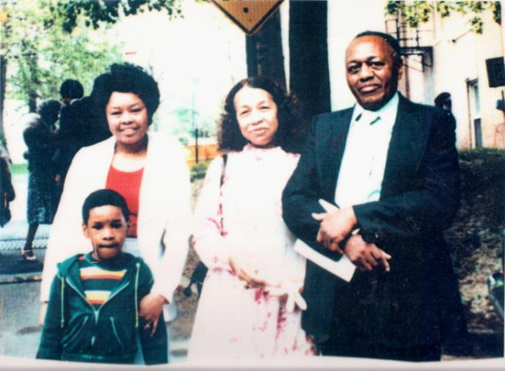
Annie Mae Newsome
February 22, 1920 – November 26, 2014

Slide 3
Annie Mae Newsome
February 22, 1920 – November 26, 2014

Slide 4
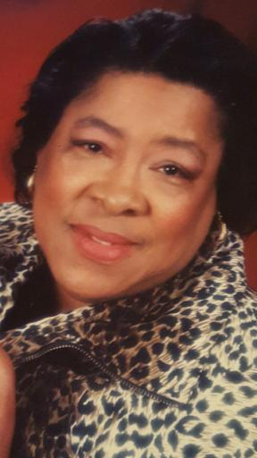
Lillie Mae Sutton Fells
February 27, 1937 – April 17, 2013

Slide 5
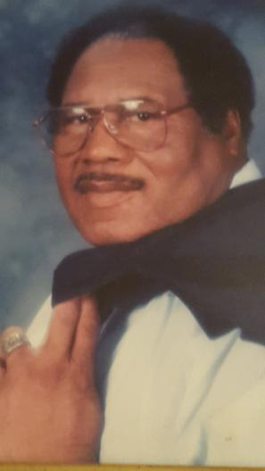
Timothy L. Fells
January 19, 1931 – April 23, 2013

Slide 6
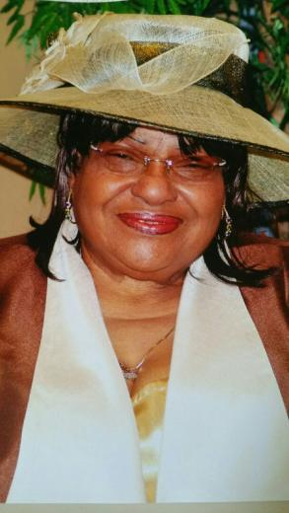
Lizzie M. Holley Ballard
June 1, 1941 – May 17, 2016

Slide 7
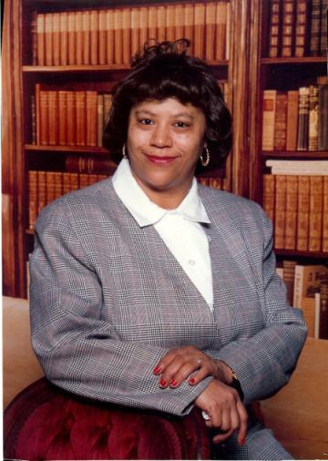
LaVerne Sutton
June 18, 1950 – January 13, 2014

Slide 8
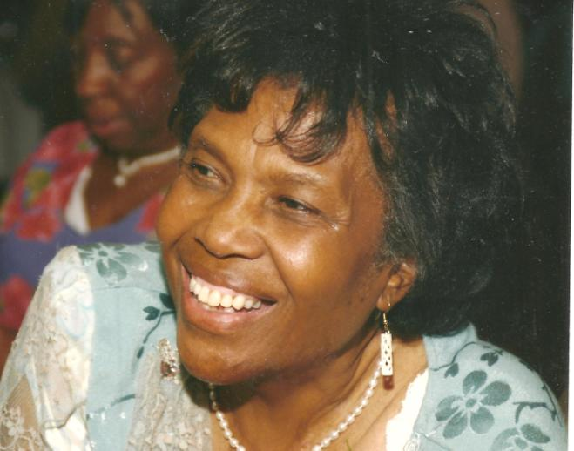
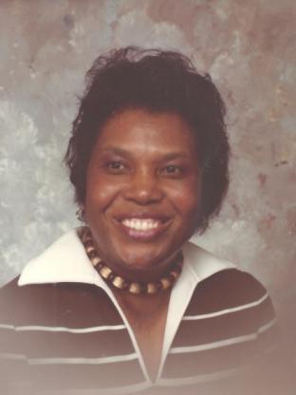
Ruth May Sutton
November 26, 1933 - March 7, 2016

Slide 9
Ruth May Sutton
November 26, 1933 - March 7, 2016

Slide 10
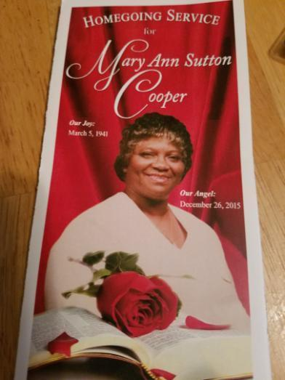
Mary Ann Sutton Cooper
March 5, 1941 – December 26, 2015

Slide 11
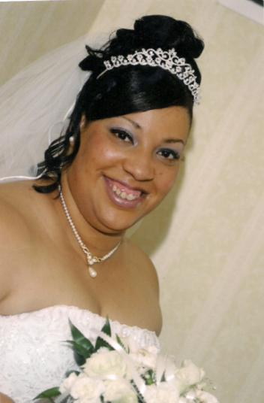
Yvette M. Roberts
January 31, 1966 – February 19, 2005

Slide 12
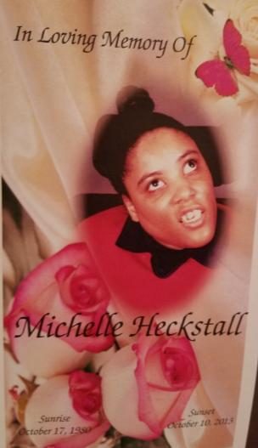
Michelle Heckstall
October 17, 1980 – October 10, 2013

Slide 13
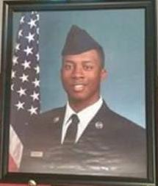
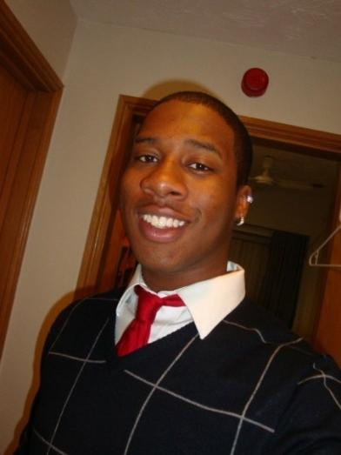
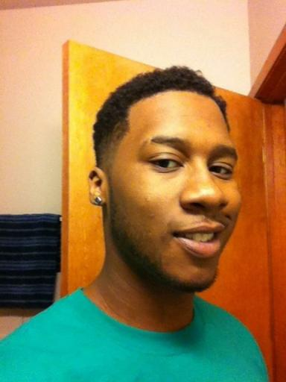
Storm Speller
August 16, 1990 – September 11, 2015

Slide 14
Storm Speller
August 16, 1990 – September 11, 2015

Slide 15
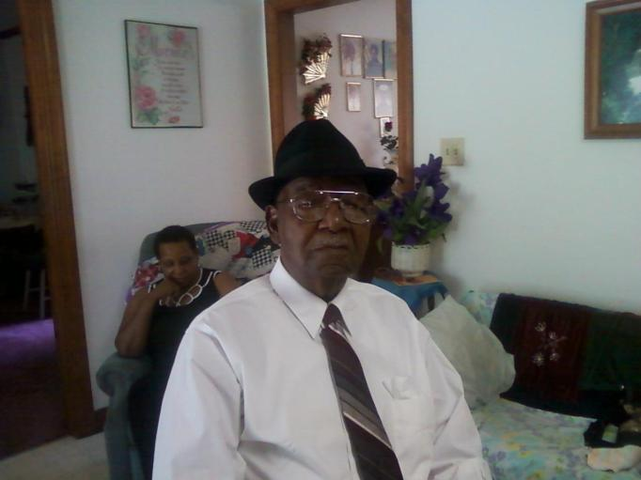
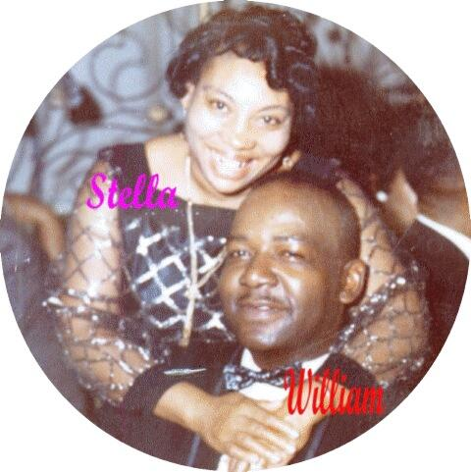
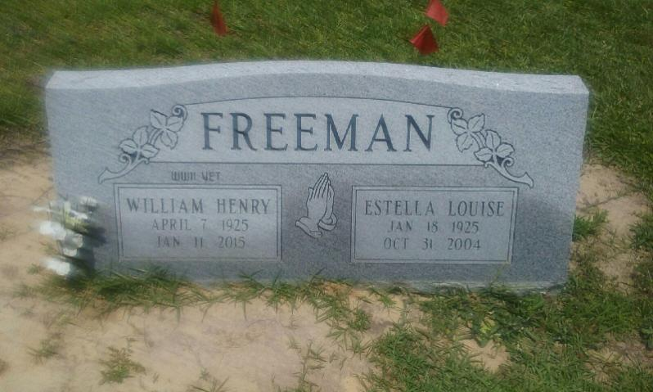
William Henry Freeman
April 7, 1925 – January 11, 2015

Slide 16
William Henry Freeman
April 7, 1925 – January 11, 2015

Slide 17
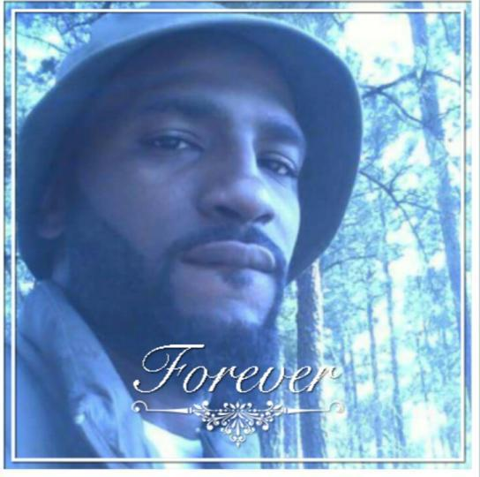
Michael R. Johnson II
February 22, 1988 – May 15, 2016

Slide 18
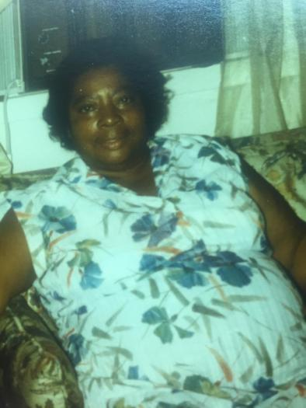
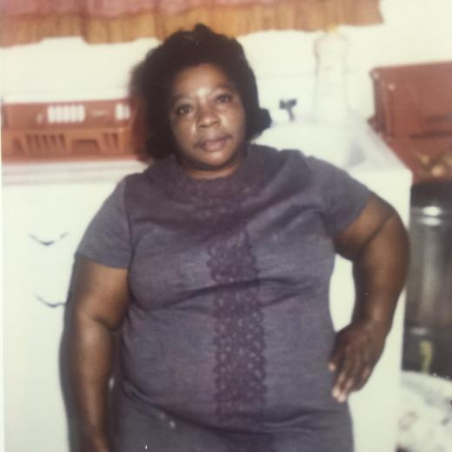
Annie Bell Blount Heckstall
September 12, 1915 – January 17, 1994

Slide 19
Annie Bell Blount Heckstall
September 12, 1915 – January 17, 1994

Slide 20
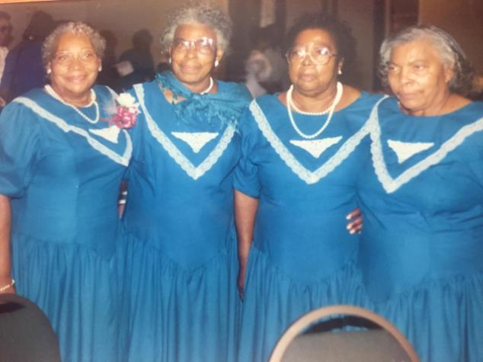
Blount, Freeman, Newsome, Sutton
Estella, Janie, Annie Bell, and Mary Augusta
September 12, 1915 – January 17, 1994

Slide 21
As long as we live, they too shall live, for they are a part of us, as we remember them. Let’s cherish the moments we have while continuing to build memories with family today.

